Slide 1
POULTRY HOUSE TRACKING USING IoT
PRESENTERS:
PRASETHA N
KAVIYA PRIYA P

Slide 2
ABSTRACT The use of Internet of Things (IoT)-based systems has recently been extended with incalculable Internet resources. The system exemplifies the development of novel systems that allow for remote control and monitoring regardless of distance or time. Temperature and humidity levels in a poultry house should be tracked on a regular basis to ensure the system runs smoothly. To prevent accidents that result in excessive temperature increases, it must be controlled 24 hours a day, seven days a week. This paper focuses on the IoT solution for monitoring temperature and humidity conditions, as well as the presence of electricity connectivity, at any time and in any place. Keywords - Embedded system, Raspberry Pi, IoT, Mobile apps

Slide 3
OBJECTIVE
To monitor the Poultry farm house with recent IoT technologies

Slide 4
Internet Of Things
Physical devices : receive and transfer data over wireless networks with limited human intervention
Cloud based → simple file management to switching off devices.

Slide 5
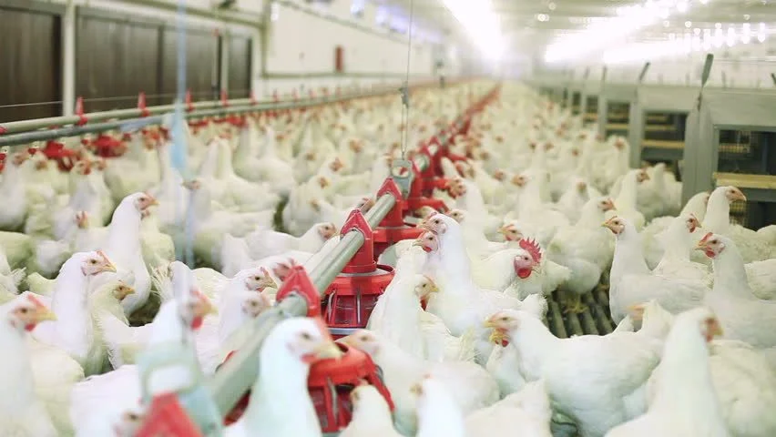
Essential Factors For Birds
Temperature
Feed
Water
Light

Slide 6
System-Components & Functions
Checking Stations
Multi-jump hubs
Poultry cultivate
PIC microcontroller→ Raspberry Pi→ Mobile App via Wifi

Slide 7
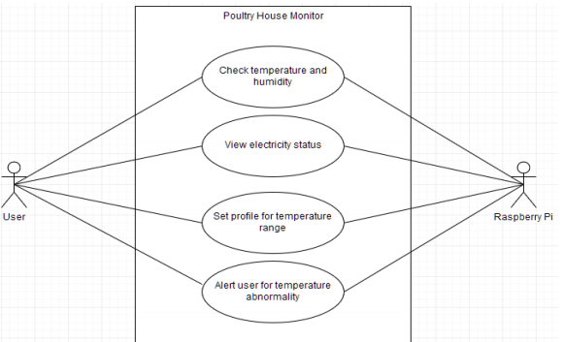
Use Case Diagram

Slide 8
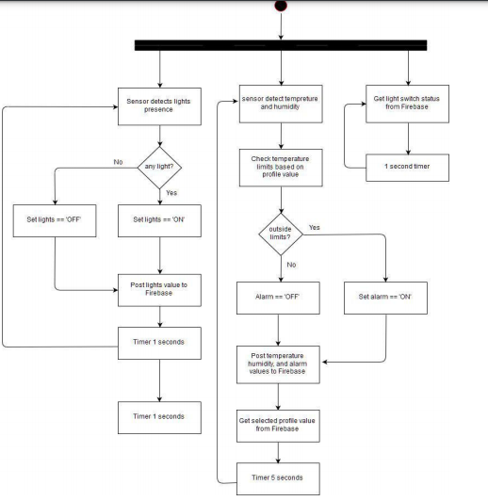
Raspberry Pi circuit activity diagram

Slide 9
Implementation
Deduce Electricity availability
Temperature Analysing
Connect cloud database
Data to Smartphone
Abnormality alarm

Slide 10
Raspberry Pi
Setup, configure and connect to database
Connect a power bank which acts as UPS
Raspberry pi starts booting with program every 10 Seconds

Slide 11
Advantages
Reduces manual monitoring
Simple and affordable
Quicker and accurate response

Slide 12
Conclusion
Advancement of technologies : monitor and improve the prediction with better accuracy

Slide 13
REFERENCES:
[1] N.Suma, S. R. Samson, S.Saranya,G.Shanmugapriya, R.Subhashri, “IoT Based
Smart Agriculture Monitoring System”.International Journal on Recent and
Innovation Trends in Computing and Communication, 5, 2, 177-181, 2017
[2] M P Archana, S K Uma, TM Raghavendran Babu, “Monitoring and Controlling of Poultry Farm Using IoT”.International Journal of Innovative Research in Computer and Communication Engineering, Vol. 6, 4, 3573-3579, 2018.

